Slide 1

Methods; Parsing; Format operator
Python Programming | Loops, string, files, list, dictionaries and tuples
Course: Python Programming | Chapter: Loops, string, files, list, dictionaries and tuples | Program: Bachelor of Computer Science and Engineering
DISCOVER · LEARN · EMPOWER
Notes:
Welcome everyone to today's session on Python string manipulation. We will focus specifically on methods, parsing techniques, and the format operator. These tools are essential for processing text data efficiently in real-world engineering applications.

Slide 2
Course Outcomes
SLIDE 2 / 14
Course Outcome
CO | BT LEVEL | DESCRIPTION
CO1 | BT1 | Understand the syntax, control structures, and basic constructs of Python programming language
CO2 | BT3 | Apply functions, modules, and exception handling for modular program development
CO3 | BT3 | Implement data structures including lists, tuples, dictionaries, and sets for efficient data processing
CO4 | BT4 | Analyze and manipulate files, strings, and perform data handling operations
CO5 | BT5 | Design and develop real-world applications integrating multiple Python concepts
Chandigarh University
2 / 14
Notes:
Today's lecture directly addresses two specific course outcomes. CO3 requires us to implement data structures, which we do by manipulating lists and dictionaries of strings. CO4 focuses on analyzing and manipulating files and strings, which is the core of our parsing and formatting discussion.

Slide 3
Learning Objectives
SLIDE 3 / 14
Learning Outcomes
1
Analyze string methods to modify text data effectively
2
Apply parsing techniques to extract specific substrings
3
Utilize the format operator for structured data output
4
Evaluate common pitfalls in string manipulation logic
5
Demonstrate proficiency in handling mixed data types
Chandigarh University
3 / 14
Notes:
By the end of this session, you will be able to analyze various string methods and apply them correctly. You will learn to parse complex strings to extract specific data points. Finally, you will master the format operator to create professional, structured output for reports.

Slide 4
Lecture
SLIDE 4 / 14
String Methods Overview
1
String methods are functions attached to string objects for manipulation
2
Methods like upper() and lower() change case without altering original
3
strip() removes leading and trailing whitespace characters automatically
4
split() divides a string into a list based on a delimiter
5
join() combines a list of strings into a single string result
6
Methods return new strings rather than modifying the original in place
7
Understanding return values is crucial for chaining multiple operations together
Chandigarh University
4 / 14
Notes:
Think of string methods as tools in a toolbox that belong to the string itself. When you call upper(), the original string remains unchanged, but a new uppercase version is returned. This immutability is a key concept in Python that prevents accidental data loss during processing.

Slide 5
Lecture
SLIDE 5 / 14
Parsing with split and find
EXAMPLE
'A,B,C'.split(',') returns ['A', 'B', 'C'] list
• Parsing extracts specific data segments from a larger text string
• split() breaks text into a list using a specified separator character
• find() locates the index of the first occurrence of a substring
• rfind() locates the index of the last occurrence of a substring
• Parsing allows conversion of raw text into structured list data
• Using indices from find() allows precise extraction of substrings
Chandigarh University
5 / 14
Notes:
Parsing is the process of breaking down raw text into usable data. If you have a CSV line like 'Name,Age,25', split() separates it into a list. You can then use find() to locate specific markers and extract data between them programmatically.

Slide 6
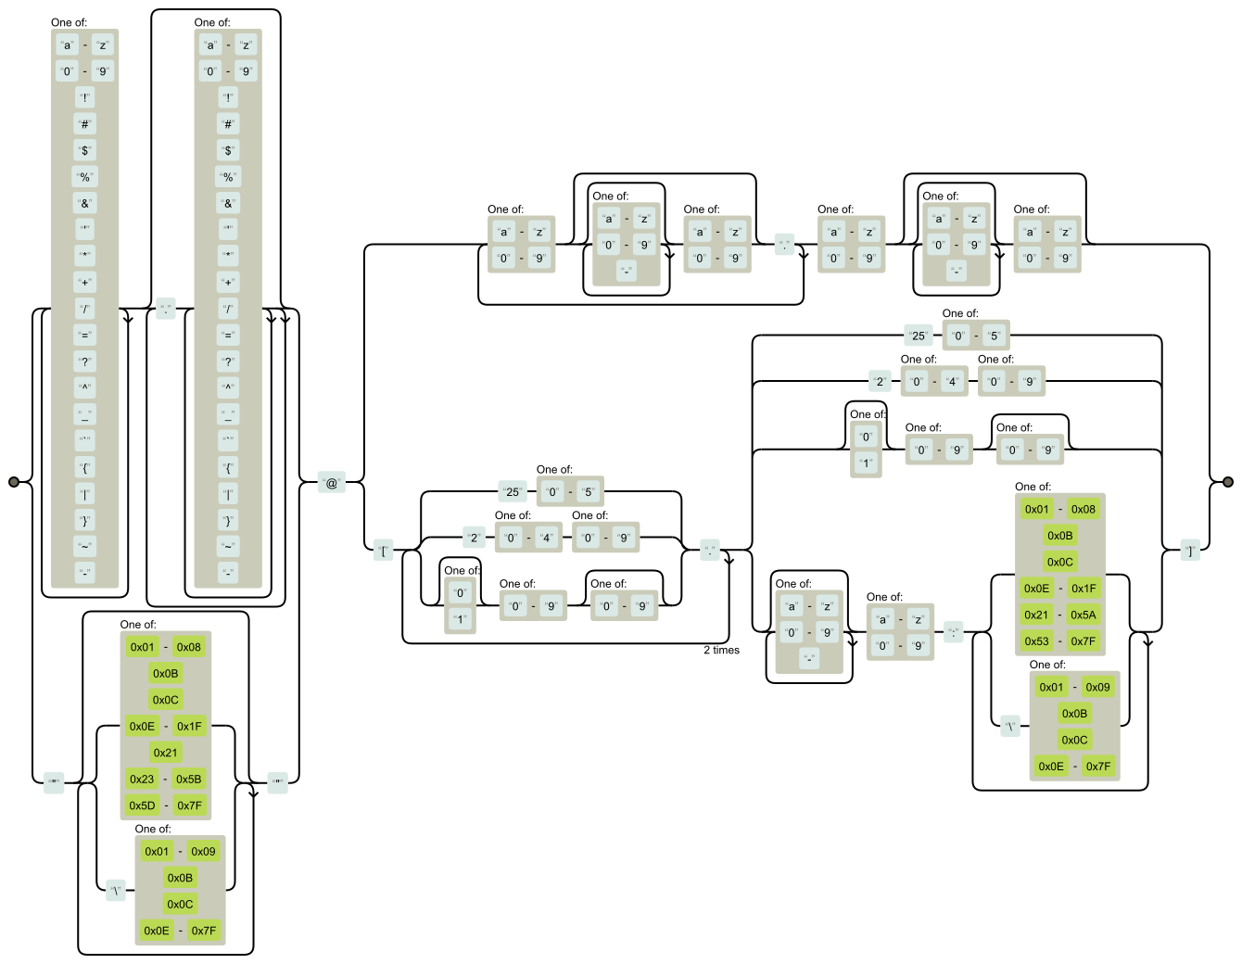
Lecture
SLIDE 6 / 14
Parsing with Regular Expressions
1
Regular expressions define complex patterns for string matching and parsing
2
The re module provides functions like search() and match() for parsing
3
Patterns use special characters like dots and asterisks for flexibility
4
Parsing with regex handles unstructured data better than simple split
5
Example pattern r'd+' matches one or more consecutive digits
6
Extracting emails or phone numbers requires specific regex pattern logic
7
Regex parsing is powerful but requires careful pattern construction
Source: emailregex.com
Chandigarh University
6 / 14
Notes:
While split() works for simple delimiters, regular expressions handle complex patterns. For instance, extracting an email address from a log file requires matching specific character sequences. This method is essential for parsing unstructured data where delimiters are inconsistent.

Slide 7
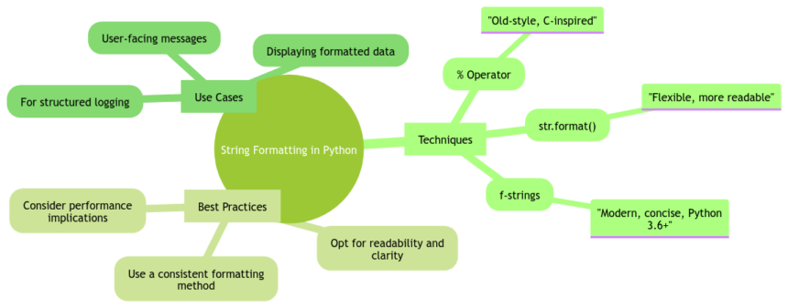
Lecture
SLIDE 7 / 14
Format Operator Basics
EXAMPLE
'Hello {}' .format('World') results in 'Hello World'
• The format operator inserts variables into a string template
• Syntax uses curly braces {} as placeholders for variable values
• The format() method replaces placeholders with provided argument values
• Placeholders can be numbered to control the order of insertion
• Format strings allow mixing text and dynamic data seamlessly
• This operator is fundamental for generating dynamic reports and logs
Source: www.codewithc.com
Chandigarh University
7 / 14
Notes:
The format operator is your primary tool for dynamic string construction. You define a template with empty slots, and the format method fills them with your data. This is far superior to concatenation for readability and error prevention in complex strings.

Slide 8
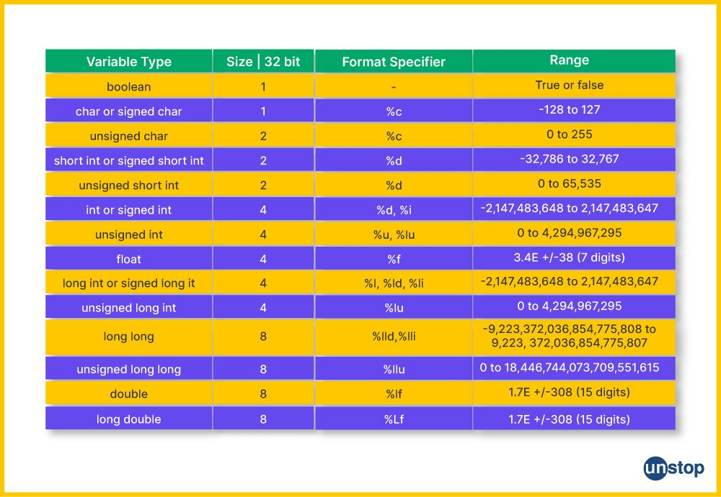
Lecture
SLIDE 8 / 14
Format Operator Specifications
EXAMPLE
'{:>10}'.format(42) produces ' 42' with padding
• Specifiers control alignment, width, and precision of formatted output
• Syntax {value:width.precision} allows precise control over display
• Left alignment uses , center uses ^
• Precision .2f limits floating point numbers to two decimal places
• Specifiers ensure consistent column widths in tabular data output
• Misusing specifiers can lead to truncated or misaligned data display
Source: d8it4huxumps7.cloudfront.net
Chandigarh University
8 / 14
Notes:
You can control exactly how your data looks using specifications. If you need a number to always take up ten characters, you specify the width. Precision controls decimal places, ensuring financial data is displayed consistently without unnecessary trailing zeros.

Slide 9
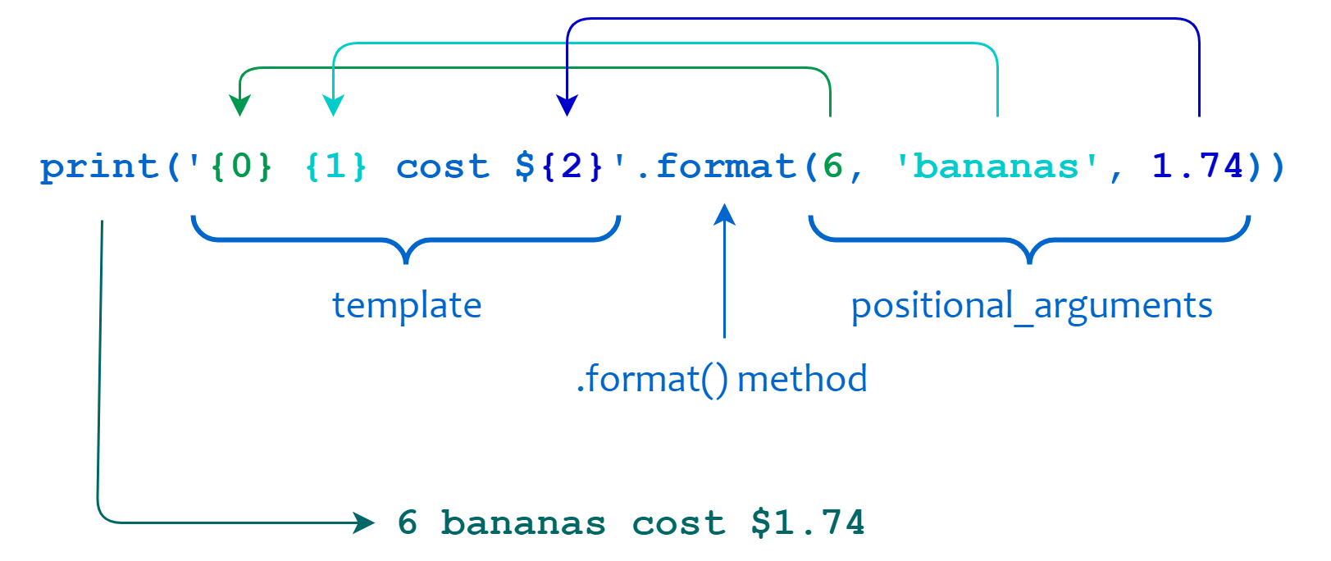
Worked Example
SLIDE 9 / 14
Data Formatting
GOVERNING EQUATION
Data: name='Alice', grade=95.5, max_score=100
TASK
Format student name and grade into a standardized report string
CODE
f'Report: {name}, Score: {grade:.1f}/100' produces output
RESULT
'Report: Alice, Score: 95.5/100' with one decimal place
• Using f-strings or format() ensures consistent decimal precision
• This approach prevents manual string concatenation errors
• Output is ready for printing or writing to a file directly
Source: files.realpython.com
Chandigarh University
9 / 14
Notes:
Let's look at a concrete example. We have a student named Alice with a score of 95.5. Using the format operator with a precision specifier, we ensure the score always shows one decimal place. This creates a clean, professional report line without manual string joining.

Slide 10
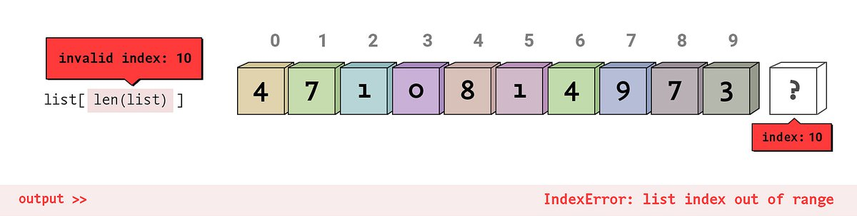
Lecture
SLIDE 10 / 14
Common Pitfalls in Parsing
1
Splitting on wrong delimiter causes incorrect list segmentation
2
Empty strings in lists can cause index errors during processing
3
Case sensitivity in find() leads to missed substring matches
4
Assuming fixed-width parsing fails with variable length data
5
Not handling exceptions when parsing malformed input data
6
Overlooking whitespace characters in string comparison operations
7
Parsing logic must account for edge cases in real-world data
Source: storage.googleapis.com
Chandigarh University
10 / 14
Notes:
Parsing is prone to errors if you assume data is perfectly clean. A common pitfall is splitting on a delimiter that appears within the data itself. Always validate your input and handle cases where the expected substring might be missing to avoid runtime crashes.

Slide 11
Lecture
SLIDE 11 / 14
Common Pitfalls in Formatting
1
Mismatched placeholder count causes ValueError exceptions
2
Using wrong type specifier results in unexpected string output
3
Forgetting to escape curly braces in literal text output
4
Exceeding precision limits truncates data unexpectedly
5
Mixing positional and keyword arguments creates confusion
6
Not specifying width can lead to misaligned column output
7
Always test format strings with edge case values first
Chandigarh University
11 / 14
Notes:
When formatting, a mismatch between placeholders and arguments is a frequent error. If you have two braces but only one value, Python will raise an exception. Also, remember that curly braces are special characters, so you must escape them if you want to print them literally.

Slide 12
Lecture
SLIDE 12 / 14
Integration with Data Structures
1
Methods allow processing lists of strings efficiently in loops
2
Parsing converts file lines into dictionaries for structured storage
3
Formatting prepares data for writing to output files or logs
4
Combining split and format creates robust data processing pipelines
5
Iterating over a list allows applying methods to every element
6
This integration supports the implementation of efficient data structures
7
Data handling operations become modular and reusable with these tools
Chandigarh University
12 / 14
Notes:
These techniques are not isolated; they work best when integrated with data structures. You can loop through a list of strings, parse each one, and format the results for storage. This modular approach is key to implementing efficient data processing pipelines in Python.

Slide 13
Lecture
SLIDE 13 / 14
Key Takeaways
1
String methods modify text and return new immutable string objects
2
Parsing techniques like split and regex extract specific data segments
3
Format operator provides precise control over string output appearance
4
Always validate input data to prevent parsing and formatting errors
5
Integration with loops and data structures enables complex data handling
Chandigarh University
13 / 14
Notes:
To summarize, remember that strings are immutable and methods return new objects. Parsing is essential for extracting data, while formatting ensures it looks correct. Finally, always validate your data to avoid common pitfalls in your engineering applications.

Slide 14
Lecture
SLIDE 14 / 14
References
PYTHON
A Practical Learning Approach, 1st Edition — T.S. Murugesh, Shriram K. Vasudevan, Sini Raj Pulari
• Learning Python, 6th Edition — Mark Lutz
• Starting Out with Python, Global Edition, 6th Edition — Tony Gaddis
• Introduction to Python Programming and Data Structures, 3rd Edition — Y. Daniel Liang
Chandigarh University
14 / 14
Notes:
For further reading, I recommend the textbooks listed here. Mark Lutz's book offers deep insights into Python internals. Tony Gaddis provides excellent practical examples, while Liang and the team at Chandigarh University offer structured approaches to data structures and programming.

